Slide 1
The Effect of Disgust on Moral Behavior
Natalie Morse and Sarah Quebe
Hanover College
Winter 2013

Slide 2
Moral Dilemma (Incest)
“Julie and Mark are brother and sister. They are travelling together in France on summer vacation from college. One night, they are staying alone in a cabin near the beach. They decide that it would be interesting and fun if they tried making love. At the very least it would be a new experience for each of them. Julie was already taking birth control pills, but Mark uses a condom too, just to be safe. They both enjoy making love, but they decide not to do it again. They keep that night as a special secret, which makes them feel even closer to each other. What do you think about that? Was it OK for them to make love?”
Haidt, 2001

Slide 3
Criteria for Moral Judgment
Moral Dilemma
Jonathan Haidt
Moral dumbfounding
“Stubborn and puzzled maintenance a judgment without supporting ideas” (Haidt, Bjorklund, & Murphy, 2000).
Moral Foundations Theory
Our focus: sanctity and degradation
Notes:
NOTES: example of brother and sister having sex (haidt’s example) associate judgement that you feel with rotten food with moral examples. --- most thinking about morality has emphasized harm or fairness.. In the incest or dog example, neither of those two things are violated. He gives these other dimensions that we have missed..
This essentially says that even when a behavior does no harm and does not seem unfair, people can still purpose that is it wrong but be unable to explain why they think it is wrong. Based on this finding, Haidt concluded that there must be other principles besides harm and fairness that people use to evaluate the rightness or wrongness of a behavior. This is where one of Haidt’s biggest contributions to the field of psychology comes in, the moral foundations theory, which produced five dimensions to be the psychological “foundations” upon which cultures construct their moralities

Slide 4
Moral Violation
Haidt and Kesebir (2010)
Morality is a primary function to discourage selfishness and encourage cooperation – Functionalism
Rozin, Haidt, and Fincher (2009)
Strong connection between physical and moral disgust
Notes:
Notes: evolutionary theory – disgust first began as a fear of disease – physical happened first, but then Rozin etc. have a theory that it was moral. Ex: elected official pocketed money.. Ahh that’s horrible! Same feeling. MOVE ZHONG TO END OF INTRO
Transition: Moral Foundations Theory is coming out of the functionalist approach.
A lot of our emotions (guilt, shame, been cheated) have evolved because we need to get a long in big groups.. You need to punish cheaters, feel angry, desire for revenge is very adaptive so you don’t get taken advantage..
TRANSITION 2: go back to first example
Priming moral disgust then physically cleanse themselves to see how that effects moral behavior.. We are priming physical disgust and seeing how that effects moral behavior

Slide 5
Disgust Affects Moral Judgment
Previous research
Cleanliness
Reduces severity of moral judgments (Schnall, Benton, & Harvey, 2008)
Disgust
Makes moral judgments more severe (Wheatley & Haidt, 2005)
Notes:
More evidence for a link between disgust and moral judgment lies within the research in which subjects are primed to feel either more pure or more impure, and then judge the wrongness of behavior. Schnall, Benton, and Harvey (2008) conducted a study that focused on a dimension from Haidt’s moral foundations theory to see the effects on moral judgment. In the first study, some participants were asked to complete a word task problem involving words such as “pure,” “wash,” “clean,” etc. while others were given neutral words. Once they finished this task, the participants rated six moral judgment situations and rated their emotions. The results indicated that participants provided lower ratings of judgment and emotions after the cleanliness priming (M = 4.98, SD = 1.26) than they did after the neutral priming (M = 5.81, SD = 1.47) (Schnall, Benton & Harvey, 1220). Wheatley and Haidt (2005) lead a study examining the opposite end of the same dimension of cleanliness—disgust. As the first study expected cleanliness to make moral judgment less severe, this study expects for disgust to make moral judgments more severe. Wheatley and Haidt used highly hypnotizable participants during their experiment. When the participants were hypnotized, they told them to feel a flash of disgust when they were presented with arbitrary words. Participants were then asked to rate moral misbehaviors explained in an essay that either did or did not include the word that induced disgust (Wheatley & Haidt, 2005). The results indicated that participants rated the stories as more disgusting when the word they were exposed to during the hypnosis was presented. The results from both studies indicate that Haidt’s dimensions have a significant effect on how we judge moral situations.

Slide 6
Moral Behavior
Zhong and Liljenquist (2006)
Helping behavior by volunteer for another study
41% that wiped hands volunteered
74% that didn’t wipe hands volunteered
When a person reflects on own wrongdoings, presents contamination and motivation to purify
Notes:
Zhong and Liljenquist (2006)
Macbeth effect
Emotional feelings of contamination
Encountering moral violations can trigger disgust
NEARLY THE SAME AS OUR STUDY BUT BACKWARDS:
Didn’t give anything to cleanse self with, used helping behavior as a means to cleanse self

Slide 7
Research Question/Hypothesis
Does being primed with physical disgust affect a person’s decision to help?
We expect to find that people who are primed with disgust will help longer than those primed with clean.
Notes:
WALK PEOPLE THOUGH IT.. Physically disgust.. If roszin etc.’s theory is correct, you should be able to cleanse yourself with a moral behavior.. Its like cleaning with the wipe.

Slide 8
Participants
N = 26
Used 24
4 males, 20 females
20 Caucasian, 2 African Americans, 1 Bi-racial
13 disgust, 11 clean
Hanover College students
Ages: 18-22

Slide 9
Method
Randomly assigned
Informed Consent in psych lounge
Directed to back room
Clean or disgust condition
Foul smelling or clean smelling
Disgust: raw salmon, sauerkraut, onion, garlic, mackeral
Clean: air fresheners, Pine-Sol, Lysol wipes
Viewed pictures

Slide 10
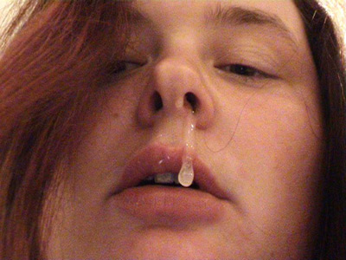
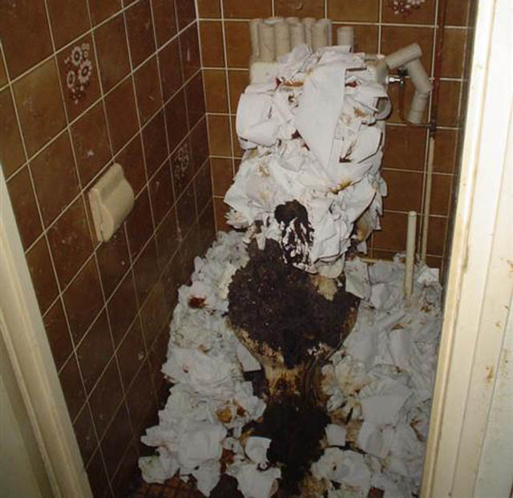
Disgust condition

Slide 11
Clean condition

Slide 12
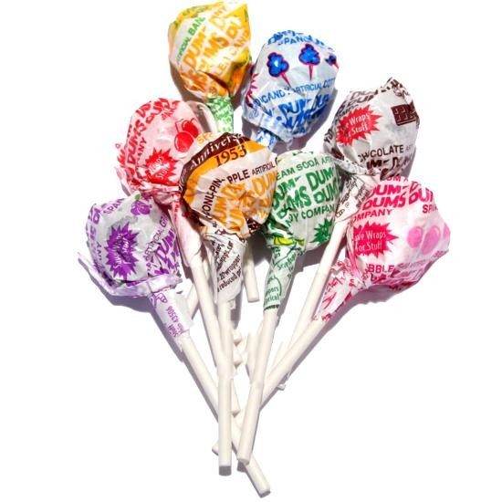
Method
Rating of pictures
Directed back to psych lounge
Demographics
Incident – Dum Dum suckers
iPhone (timing)
Bowl drops = start timer
No immediate help/stop helping = “thanks anyway” = stop timer
Immediate help & picked all up = “Thank you very much” = stop timer
Filled out Demographics
Debriefed and Dismissed
Notes:
Once bowl drops, start the timer. If the subject immediately starts helping, I began helping as well. If they did not immediately start helping, I would take a step towards the mess to see what they would do. If they didn’t help, I’d say “it’s okay, I’ll get it later” = natalie stopped timing. If they helped immediately or started helping after I stepped towards it, an out was offered by saying, “it’s ok. I can get this later” so that they had the choice to help instead of them feeling like they HAD to.

Slide 13
Results
t(21.8) = 2.21, p = .038
Notes:
Consistent with hypothesis and JHONG.

Slide 14
Discussion
Moral/Physical Equivalency of Disgust (Rozin, Haidt, Fincher, 2009; Zhong and Liljenquist, 2006)
Disgust = feel contaminated, motivated to cleanse = helping (morally cleansing)
People help to satisfy a motivation to cleanse themselves
Notes:
Haidt: if consistent with this theory, If the results are consistent with this theory, it would indicate that people who feel physically disgusted would be more likely to help because they want to cleanse themselves from the disgust they felt from the priming. For example, our study gave the participant the option to help the researcher pick up spilled Dum-Dums. If the participant stayed to help, it could have been to help themselves feel better after physically feeling gross from the disgust priming.
Cialdini: If the results were consistent with this hypothesis, it would indicate that the participants were more likely to help because they wanted relieve the negative mood stimulated by the priming by helping someone else to make themselves feel better. Generally, this hypothesis is evoked by moods of sympathy or empathy so the participant feels negatively affected by the priming, in this case disgust, and when they see someone else who is struggling or in an unfortunate situation, they help them in order to help themselves improve their mood
Dehumanization Theory: Thus, priming disgust may lead to a more dehumanized way of looking at others, evoking less sympathy. In this case, if the results were consistent with this theory, the results would also be consistent with the priming phenomenon because the participants are in a negative state and therefore acting consistently in a negative manner

Slide 15
Limitations
Experimenter Effects
Negative State Relief Hypothesis
Disgust = bad mood = helping (improves mood)
People help when it makes them feel better
Notes:
We knew the results we wanted.. We really weren’t sure which way it was going to go. Didn’t expect certain results.
Dehumanization Theory (Haslam 2006)
Make people appear animalistic dehumanizes them
Bargh, 2001

Slide 16
Questions?

